Slide 1
Procedural Programming

Slide 2
In this approach problem viewed as sequence of things to be done like reading, calculating and printing.
The POP basically consists of writing a list of instructions for the computer to follow and organizing these instructions into groups known as functions.
Number of functions are written to accomplish these tasks.The main focus is on the functions.

Slide 3
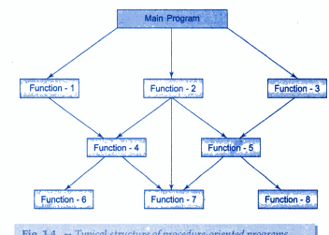
Structure of procedure oriented programs

Slide 4
We use flowchart to organize the actions.
We concentrate on the development of the functions.
But we need to concentrate on what happens to the data?
How is the data affected?

Slide 5
In the multi-function program many important data items are placed as global so that they may be accessed by all the functions.
Each function has its own local data also.

Slide 6
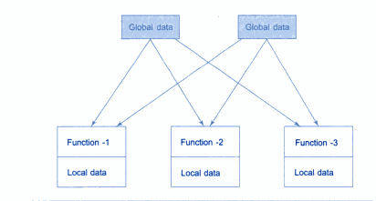
Relationship of data and functions in procedural

Slide 7
Global datae is more vulnerable.
In large program it is very difficult to identify what data is used by which function.
POP does not model real world problems very well.This is because functions are action oriented.

Slide 8
Characteristics of POP
Emphasis on doing things(algorithms).
Large prog. Divided into smaller programs known as functions.
Most functions share global data.
Data move openly around system from func. To function.
Employs top down approach in program design.

Slide 9
Disadvantages
Unrestricted Access
Data is exposed to whole program, so no security
for data.
Difficult to relate with real world objects. Separate data and functions.
Importance is given to the operation on data rather than the data.
Increases complexity when program becomes large.
A change in global data may necessitate rewriting all the functions that access that item.
Doesn’t emphasize on what to do to solve a problem.
Difficult to modify.

Slide 10
Object Oriented Programming
Emphasis on data rather than procedure.
Programs divided into objects.
Data is hidden and can not be accessed by external functions.
Objects may communicate through functions.
New data and functions can be easily be added when ever necessary.
Follows bottom –up approach in program design.

Slide 11
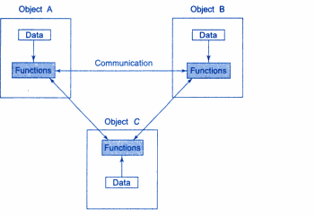
Data and functions in OOP
Notes:
The data of an object can be accessed only by the functions associated with that object.
However function of one object can access the functions of other object.

Slide 12
Basic Concepts of OOPs
Objects
Classes
Data Abstraction and Encapsulation
Inheritance
Polymorphism
Dynamic binding
Message Passing

Slide 13
Objects
Object is the basic unit of object-oriented programming.
Objects are identified by its unique name.
An object represents a particular instance of a class.
There can be more than one instance of a class.
Each instance of a class can hold its own relevant data.

Slide 14
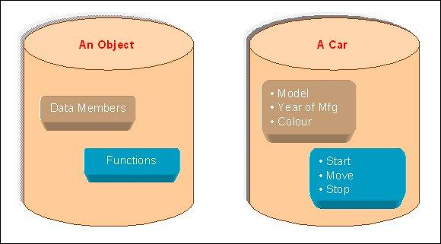
An Object is a collection of data members and associated member functions also known as methods.

Slide 15
Classes
Classes are data types based on which objects are created.
Objects with similar properties and methods are grouped together to form a Class.
Thus a Class represents a set of individual objects.
Characteristics of an object are represented in a class as Properties.

Slide 16
The actions that can be performed by objects become functions of the class and are referred to as Methods.
No memory is allocated when a class is created.
Memory is allocated only when an object is created, i.e., when an instance of a class is created.
Eg: Mango, apple are objects of class fruits.
Notes:
Class of Cars under which Santro Xing, Alto and WaganR represents individual Objects.
In this context each Car Object will have its own, Model, Year of Manufacture, Color, Top Speed, Engine Power etc., which form Properties of the Car class.
he associated actions i.e., object functions like Start, Move, and Stop form the Methods of Car Class.

Slide 17
Inheritance
Inheritance is the process of forming a new class from an existing class or base class.
The base class is also known as parent class or super class.
The new class that is formed is called derived class.
Derived class is also known as a child class or sub class..

Slide 18
Inheritance helps in reducing the overall code size of the program, which is an important concept in object-oriented programming
permits objects of a more specific class to inherit the properties (data) and behaviors (functions) of a more general/base class
ability to define a hierarchical relationship between objects

Slide 19
Polymorphism
Term means the ability to take more then one form.
Polymorphism allows routines to use variables of different types at different times.
An operator or function can be given different meanings or functions.
Polymorphism refers to a single function or multi-functioning operator performing in different ways.

Slide 20
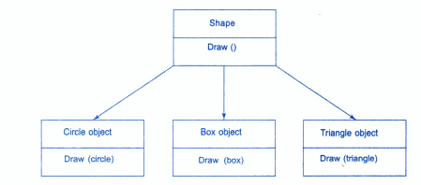

Slide 21
Data Abstraction and Encapsulation
Data Encapsulation combines data and functions into a single unit called Class
When using Data Encapsulation, data is not accessed directly; it is only accessible through the functions present inside the class.
Data Encapsulation enables the important concept of data hiding possible.

Slide 22
Data Abstraction increases the power of programming language by creating user defined data types.
Data Abstraction also represents the needed information in the program without presenting the details.
Eg:calling sort() ,user don’t know the actual working behind it.

Slide 23
Dynamic Binding
Refers to linking of a procedure call to the code to be executed in response to the call.
It means that the code associated with a given procedure call is not known untill the time of the call at run-time.
It is associated with polymorphism and inheritance
A function call associated with polymorphic reference depends on the dynamic type of that reference
Notes:
Eg: in procedure “draw” it will inherit all the properties of base class but it is unique to each object
That will b known at run time.

Slide 24
Message Passing
An OOP consists of a set of objects that communiccate with each other.
Objects communicate with each other by sending and receiving messages .
A message for an object is a request for the execution of a procedure and therefore will invoke a function in the receiving object.

Slide 25
Message Passing involves :name of object,the name of the function,the information to be sent.

Slide 26
Advantages of OOP
OOP provides a clear modular structure for programs which makes it good for defining abstract datatypes where implementation details are hidden and the unit has a clearly defined interface.
OOP makes it easy to maintain and modify existing code as new objects can be created with small differences to existing ones.
OOP provides a good framework for code libraries where supplied software components can be easily adapted and modified by the programmer. This is particularly useful for developing graphical user interfaces.

Slide 27
Writing and Editing Programs
Program written to be converted into executable file.
Software used to write program is called text editor.
Text editor helps to enter, change and store character data.
After completion of program, file is saved to disk and this file is then input to the compiler, it is called source file.

Slide 28
COMPILING PROGRAM
Complier converts source file into machine language.
Complier consist of 2 program-preprocessor and translator.
Preprocessor prepares code for compilation and translator actually converts the code in machine language.

Slide 29
LINKER
It assembles all the functions i.e. functions written by the programmer, input/output processes, and mathematical library functions into executable program i.e.it links all the functions with program.

Slide 30
LEC-2
STRUCTURE OF C++

Slide 31
Parts of a C++ Program
comment
// sample C++ program
#include <iostream>
using namespace std;
int main()
{
cout << "Hello, there!";
return 0;
}
preprocessor
directive
which namespace
to use
beginning of
function named main
beginning of
block for main
output
statement
string
literal
end of block
for main
send 0 to
operating system
2-<number>
Notes:
Main function contain two types of code :defination and statements
Defination describes the data that that will b used in function.
Statement is the set of instruction.

Slide 32
Namespaces allow to group entities like classes, objects and functions under a name. This way the global scope can be divided in "sub-scopes", each one with its own name.
The format of namespaces is:
namespace identifier
{
entities
}
Notes:
This statement tells the compilier where to look for the names in the library.

Slide 33
#include <iostream>
using namespace std;
namespace first
{
int x = 5;
int y = 10;
}
namespace second
{
double x = 3.1416;
double y = 2.7183;
}
int main ()
{
using first::x;
using second::y;
cout << x << endl;
cout << y << endl;
cout << first::y << endl;
cout << second::x << endl;
return 0; }

Slide 34
Identifiers: Allows us to name data and other objects in the program.
Each piece of data is stored in the computer is stored at a unique address.
Valid names are symbols like A through Z, a through z , the digits 0 through 9, and the underscore.

Slide 35
The first character must be alphabetic character or underscore.
The identifier must consists of alphabetic characters , digits and underscores.
The identifier cannot be a reserved word.
Valid names are
A
Student_name

Slide 36
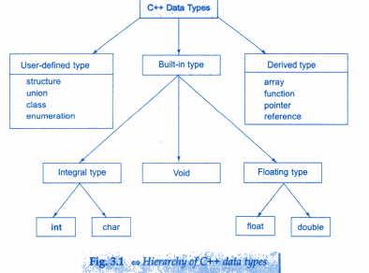

Slide 37
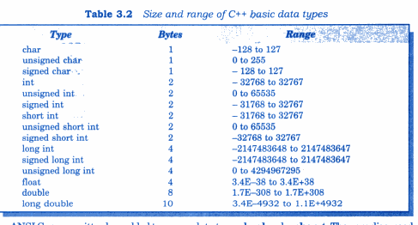

Slide 38
Data types
Basic data types
Void
Integer
Char
Float
Boolean

Slide 39
The void has no value and no operations.
Both set of operations and values is empty.
It can be represented as generic type i.e can represent any of the standard type.

Slide 40
Integer
type | sign | Byte size | Number of bits | Minimum value | Maximum value
Short int | Signed Unsigned | 2 | 16 | -32,768 0 | 32,767 65535
Int | Signed Unsigned | 2 | 16 | -32,768 0 | 32,768 65535
Long int | Signed Unsigned | 4 | 32 | -2,147,483,648 0 | 2,147,483,648

Slide 41
Character has ascii values
Boolean has two values true(1)
False(0)

Slide 42
Float
Type | Byte size | Number of bits
Float | 4 | 32
Double | 8 | 64
Long double | 10 | 80

Slide 43
Variables
Variable: a storage location in memory
  Has a name and a type of data it can hold
  Must be defined before it can be used:
  int item;

Slide 44
Literal: a value that is written into a program’s code.
"hello, there" (string literal)
12 (integer literal)

Slide 45
A variable name should represent the purpose of the variable. For example:
itemsOrdered
The purpose of this variable is to hold the number of items ordered.

